Slide 1

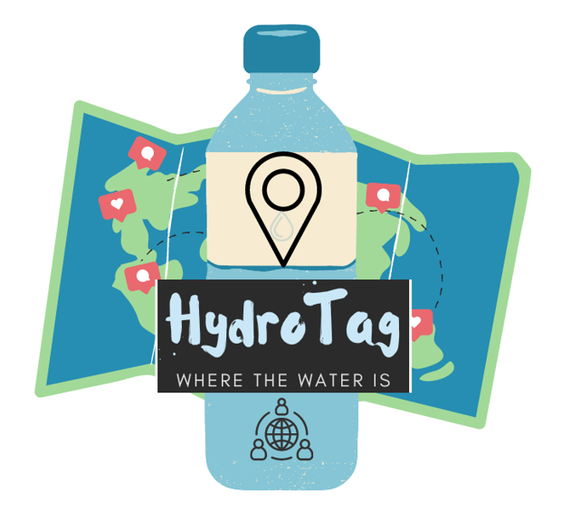
HydroTag 7/1/23
Team members:
Andrew Susanto (Product Owner)
Summit Kaushal
Evelyn Johnson
Yahya Tamur (Scrum Master)
Dingjiang Liang (David)

Slide 2
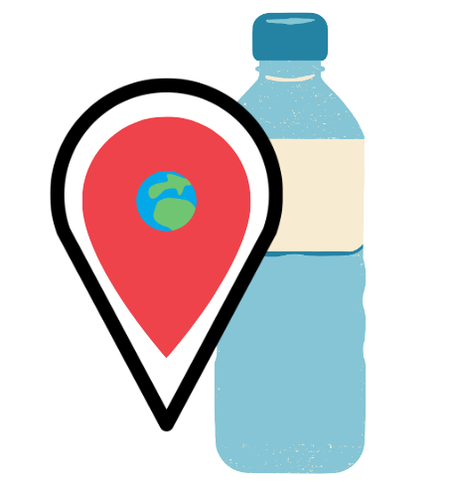

HydroTag
Problem: No available public database of usable water fountains
Opportunity: Allows users to discover and track nearby water sources, while also providing valuable insights on quality, exact locations, and user reviews, all in a single, intuitive interface
Who cares?
Individual users
Personal aspect - save personalized info
Social aspect - connect with community
Fitness Trainers and Coaches
hydration during physical activity
Parents and Educators
engaging way to learn and teach
Healthcare Providers & Health Enthusiasts
encourage wellness/health
Water Bottle/Hydration Companies
App partnership/monetization
Notes:
WHOM WILL IT HELP?
Individual Users: Anyone seeking to improve their health and hydration habits will care about this app. Regular hydration can lead to improved physical health, mental clarity, and overall well being. The RPG elements and the social aspect would make the process of staying hydrated fun and engaging, helping motivate individuals to drink more water.
Health Enthusiasts: People who are conscious about their health and wellness would find this app useful. The app could provide a fun and unique way to ensure they're staying hydrated, especially during physical activities.
Fitness Trainers and Coaches: They could use this app as a tool to encourage their clients or team members to stay hydrated, track their hydration levels, and promote healthier habits.
Parents and Educators: The app could be a useful tool to encourage children and students to drink more water. The game-like aspect would make the process fun and enjoyable for younger audiences.
Healthcare Providers: Doctors and other healthcare providers could recommend this app to patients who need to improve their hydration for health reasons.
Companies/Corporations: Corporations that promote wellness in the workplace could endorse this app to encourage their employees to maintain good hydration habits. This could potentially improve productivity and reduce health-related issues among staff.
Water Bottle and Hydration Product Companies: These companies could form partnerships with the app for promotional activities, incentivizing users to purchase their products for additional in-app rewards or features.

Slide 3
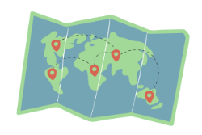


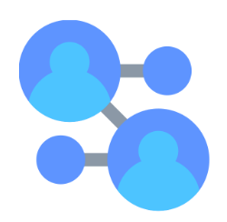
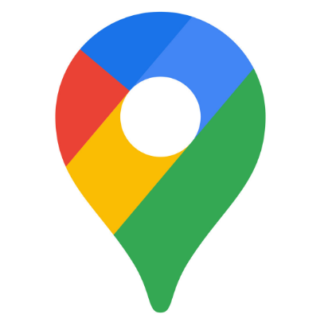

Project Scope
Interactive Map
Account Creation / Login System
Integrated Friend Network
Google Maps built-in for Pins
Social and Gamifying Features
Notes:
interactive map for water fountain locations
pins can be created by the user and can be supplemented with reviews of the water fountain at the pin
pins from the user as well as the users friends are visible on their own interactive map
functional account creation and login system
user can exit and return to the app without losing their history
self-created pins are saved between sessions
built-in friend network
user can add others through an integrated friend system
users can share their pins, reviews, and most recent pin visited with each other
pin routing
user can select any pin on their map and generate the quickest route there
social and gamifying features:
daily streaks for dropping pins, badges to show off achievements, and a ranking system to show your activity compared to your friends

Slide 4
Sprint 1
[
User Stories:
As a user, I would like to add pins onto the map and review them so I can keep track of my personal experiences with these water fountains for future reference.
As a user, I would like to view pins on the map and see the reviews of the water fountains so that I can know where the nearest and best water fountains are in my area.
As a user, I would like to create an account and be able to keep my user data consistent so that I can be sure that I don’t lose my list of pins or reviews by the next time I log in again.
Spikes (exploratory work, usually in preparation of future sprints):
Research React, Node.js, Express.js, JavaScript
Google API (Maps, Routes, Places)
Firestore Database
Infrastructure tasks (acquiring tools, setting up environment):
Setup repo on GitHub
Skeleton for web application
]

Slide 5
Sprint 2
[
User Stories:
As a user, I would like to add friends on the web application so that I can see what my friends are pinning, reviewing, and so that I can share my own activity and pin collection with them
As a user, I would like to see my friends most recent pin they visited so that I can get a sneak peek into what they’re up to and how hydrated they are throughout the day
As a user, I would like to route myself from my current location to any pin that I choose so that I can find my way to specific water fountains easily through an in-app solution
Spikes (exploratory work, usually in preparation of future sprints)
Learning user data, social media aspect
Infrastructure tasks (acquiring tools, setting up environment)
Setting up database via Firestore for various users
]
Notes:
The database will contain data on users pins and will also connect users data to other users to form the social network.

Slide 6
Sprint 3
[
User Stories:
As a user, I would like to be able to access this webpage from the internet so that I can use the application on the go.
As a user. I would like to personalize my account with badges to show off my achievements in the app for my network to see
As a user, I would like to have rewards for keeping up a daily streak for every day that I log a pin or track my water intake so that I can stay motivated and hydration conscious
As a user, I would like to be able to see just how well I am hydrating and staying active in comparison to my peers through an updated ranking system for fun
Spikes (exploratory work, usually in preparation of future sprints)
Finishing up work from previous sprints
Infrastructure tasks (acquiring tools, setting up environment)
Deploying the web app
]

Slide 7
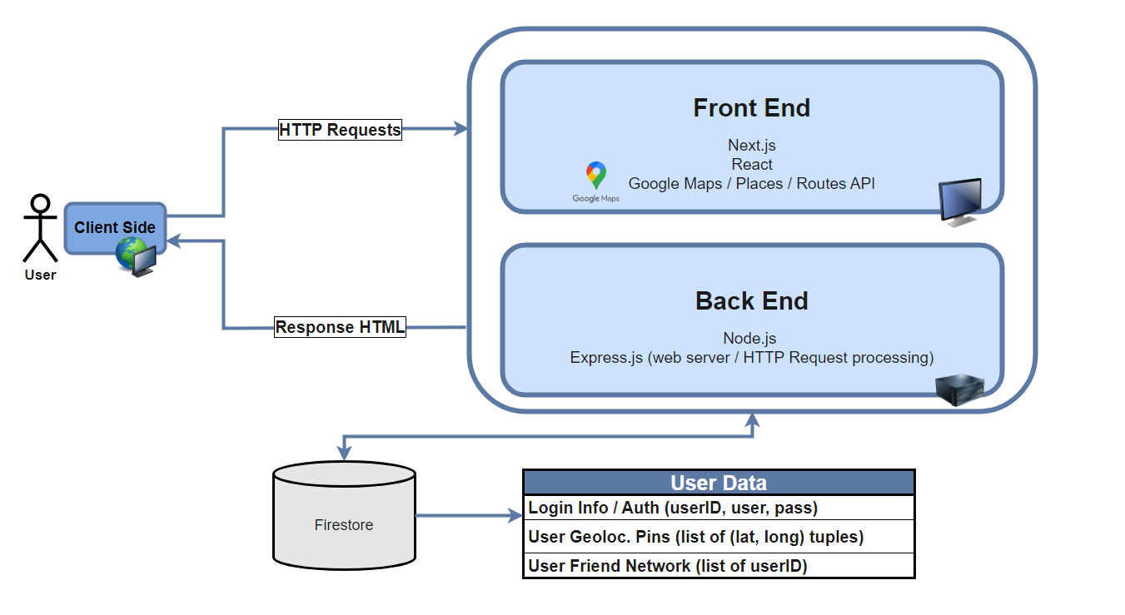

Architecture
Notes:
Architecture diagram describes the flow of information from the client-side experience to the front-end, back-end, and database implementation
User accesses the web-application through their browser
User -> Front end -> Back end -> Database

Slide 8
Technologies
[Technology 1] Programming language(s): JavaScript, html/CSS
[Technology 2] Web Framework: React, Next.js, Express.js, Node.js
[Technology 3] Development Environment: Github, VS Code
[Technology 4] API: Google Maps / Places / Routes API
[Technology 5] Database: Firestore
Notes:
Technologies. We will mainly be using JavaScript, html and CSS. The Web FrameWorks that we will be using for our backend will be Express.js, Node.js. For the front end we will be using React, Next.js, and Google Maps, routes, and places API. For our development environment we will be using GitHub and VS code. Information about the users data such as their username, email address and name are stored within the database Firestore…… it stores data as a key-value pair (dictionary)

Slide 9
Challenges/Risks
Challenges:
Skillset variety within group
Great for spreading out strengths
Each member lack experience in different areas
Lack of group project experience
Coordinating on tasks together as a team
Time management
Risks:
Learning technology on the go
Google Maps API costs money if request limit exceeded
Notes:
member lack or have no experience on js or api stuff. we have to spend time on learning all the new technology.and that could be challenging to handle.
it is our first time to use scrum management.we are unfamiliar will that. we need time to adapt the new management. And our poor team work experience could make it hard for us to cooperate with each other
this class is a 5 weeks session. And beside this class,all the member in the group still have other work or job that they need to focus on. We need to handle a lot of thing in a short period. therefore time management is also a big challenge for us.
risk
As i said above, we’re all new in this technology, so it is a risk to build the project with not familiar technology
if we make too much request to Google api, we need to pay for it. So we need to be careful to use the api

Slide 10
Minimum Viable Product (MVP)
As a user, I need to be able to create an account so that I can leave reviews.
As a registered user, I need to be able to indicate where water fountains are so that me and my friends can review them.
As a registered user, I need to be able to filter reviews by poster so that I can see my friends' reviews specifically.
Notes:
[Describe the product that you need to achieve at a minimum
to call the project a success by
listing the user stories that describe the minimum functionality
]

